Slide 1

CAPSTONE PROJECT TITLE Personalized Product Recommendation System Using K-nearest Neighbor Algorithm ITA0612 - Machine Learning for Decision Making
GUIDED BY PRESENTED BY
Dr.S.CHRISTY (professor) AJITH KUMAR.V(192421049)
Dr.SHANKARANAND (Associate Professor) JEEVA.K(192421112)
KAUSHIK.S(192421278)

Slide 2

INTRODUCTION
Online shopping platforms show many products, making it difficult for users to choose
Personalized recommendation systems help users find products they like
These systems analyze user behavior such as ratings and purchase history
The K-Nearest Neighbor algorithm finds users with similar interests
Products liked by similar users are recommended to the target user
KNN works on the principle that users with similar behavior tend to like similar products.
.

Slide 3


OBJECTIVE
To design a personalized product recommendation system using the K-Nearest Neighbor algorithm.
To analyze user behavior such as ratings, purchase history, and browsing data.
To identify similar users or products based on similarity measures.
To improve user experience by providing personalized suggestions.

Slide 4
Methodology Overview
Collect user interaction data such as ratings and purchase history
Preprocess data by cleaning, normalizing, and forming a user–item matrix
Represent users as feature vectors for similarity calculation
Apply K-Nearest Neighbor algorithm using cosine similarity
Generate personalized product recommendations based on similar users.

Slide 5
PROBLEM STATEMENT
Users face difficulty in choosing products from large catalogs
Generic recommendations are not effective
Need a system that provides personalized suggestions
Existing systems lack accuracy for new preferences

Slide 6
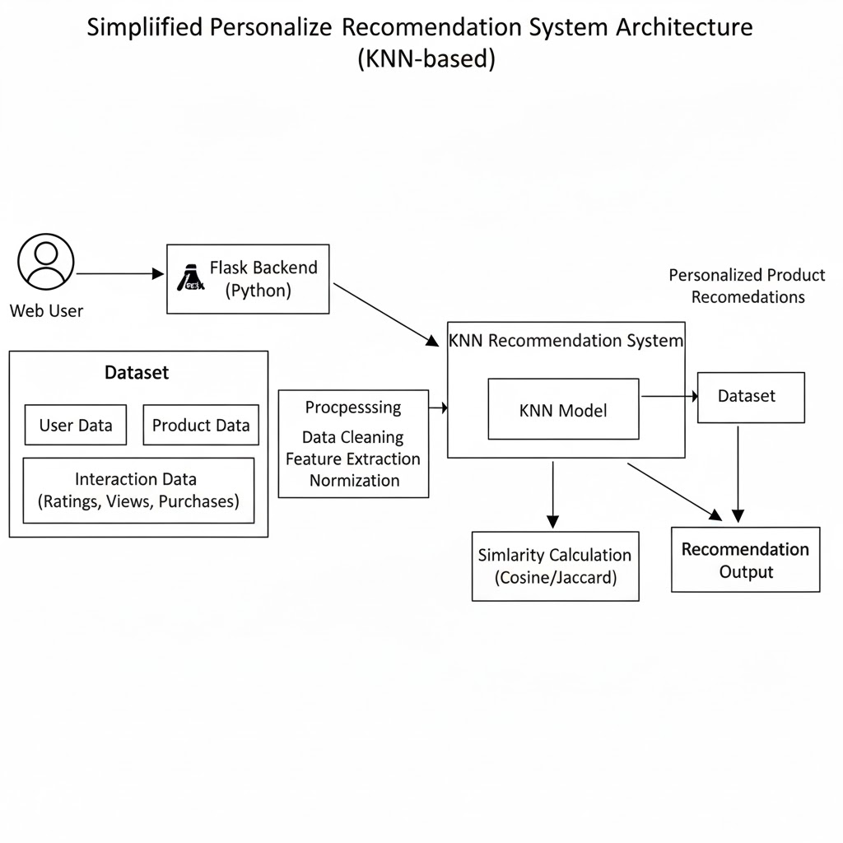
ARCHITECTURE

Slide 7

SYSTEM OVERVIEW
Data collection from users and products
Feature engineering and preprocessing
KNN-based recommendation model
Evaluation and personalized output

Slide 8
MODULE 1: DATA PREPROCESSING FOR RECOMMENDATION SYSTEM
Module Description
This module is responsible for preparing raw user interaction data for recommendation processing. Data such as user IDs, product IDs, and ratings are collected and cleaned to ensure accuracy.
Key Processes
Data collection from user interactions
Removal of duplicates and missing values
Rating normalization
User–item matrix formation
Feature vector generation
Outcome
A clean and structured dataset suitable for similarity computation and recommendation generation.

Slide 9
MODULE 2: KNN RECOMMENDATION MODEL
Module Description
This module implements the core recommendation logic using the K-Nearest Neighbor (KNN) algorithm. Each user is represented as a feature vector derived from the user–item matrix. Cosine similarity is used to calculate the distance between users.
Key Algorithms Used
K-Nearest Neighbor (KNN)
Cosine similarity
User-based collaborative filtering
Outcome
Personalized product recommendations generated based on user similarity.

Slide 10

MODULE 3: MODEL EVALUATION AND METRICS
Module Description
This module evaluates the effectiveness of the recommendation system These metrics help measure how accurately the system recommends relevant products.
Evaluation Metrics
Precision
Recall
Similarity score
Recommendation accuracy (optional)
Outcome
Validated and reliable recommendations with measurable performance indicators.

Slide 11
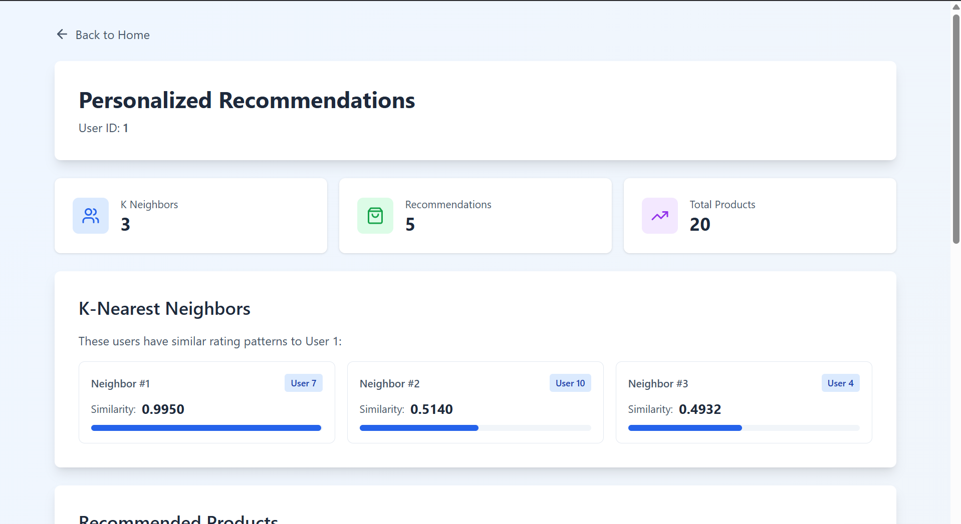
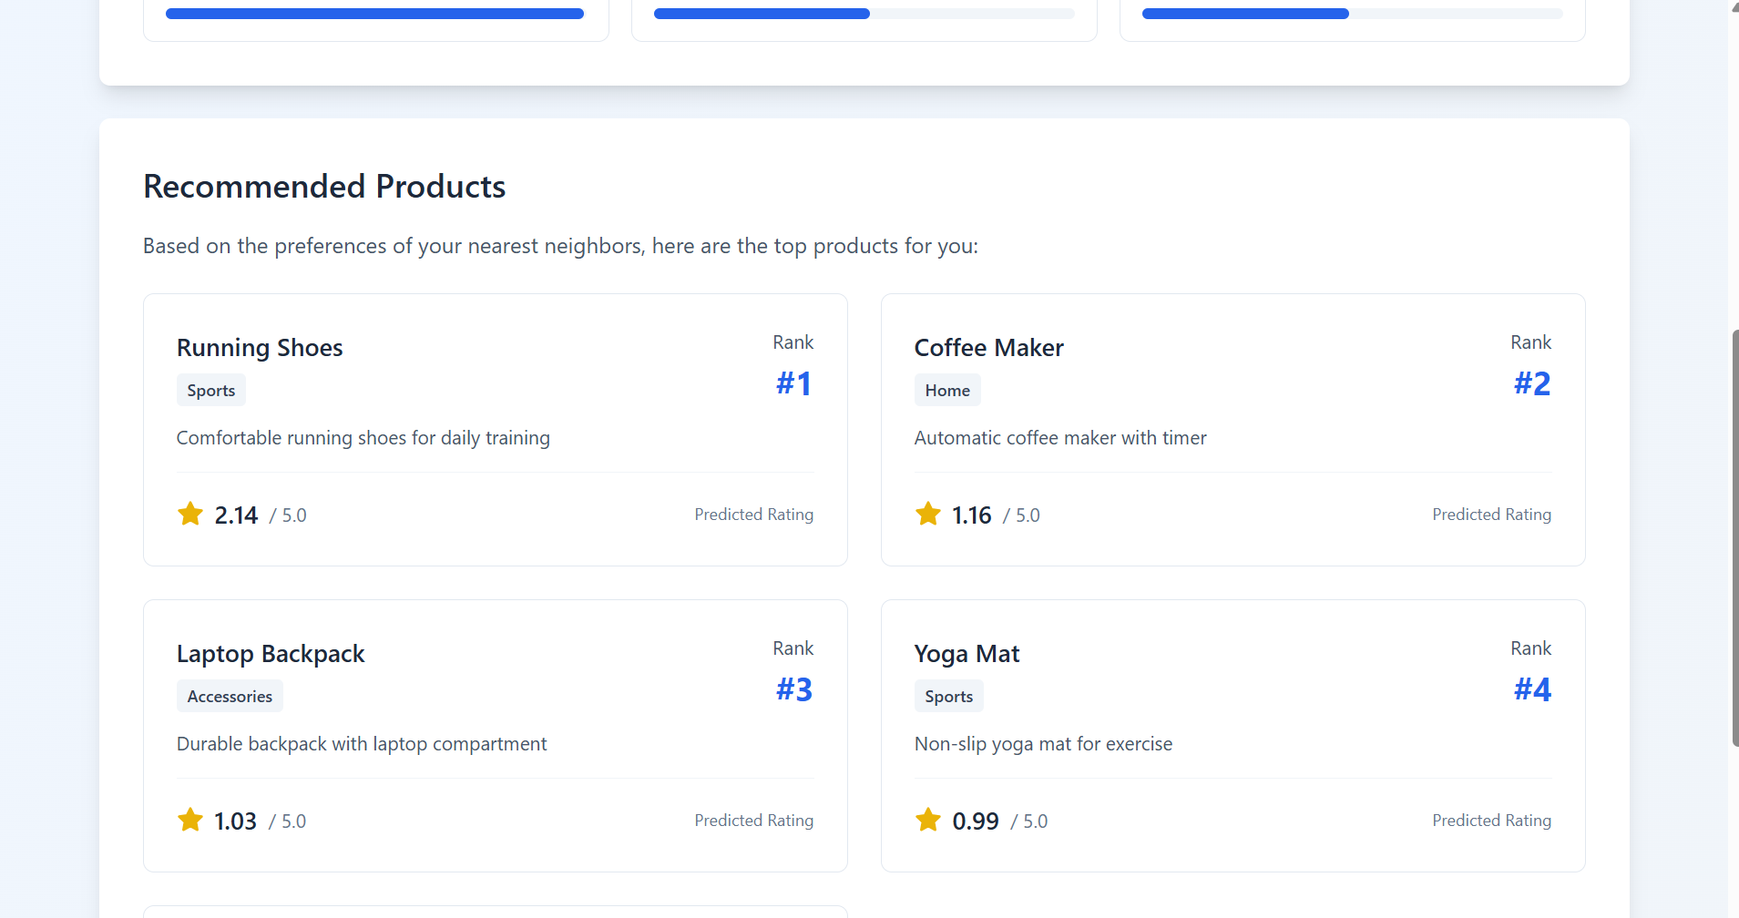
RESULT & OUTPUT

Slide 12
CONCLUSION & FUTURE SCOPE
Developed a personalized product recommendation system using KNN
Successfully identified similar users based on behavior
Generated relevant product recommendations
Improved user experience and engagement
Integrate hybrid recommendation techniques
Apply deep learning models for better accuracy
Support real-time recommendation updates

Slide 13
REFERENCES
J. Han, M. Kamber, and J. Pei, Data Mining: Concepts and Techniques, 3rd Edition, Morgan Kaufmann, 2012.
F. Ricci, L. Rokach, and B. Shapira, Recommender Systems Handbook, Springer, 2015.
S. B. Kotsiantis, “Collaborative Filtering and Recommendation Systems,” International Journal of Computer Science and Applications, 2010.
T. Hastie, R. Tibshirani, and J. Friedman, The Elements of Statistical Learning, Springer, 2009.
Scikit-learn Documentation – Nearest Neighbors

Slide 14


